Slide 1
Plant Utility System
(TKK-2210)
14/15 Semester 4
Instructor: Rama Oktavian
Email: rama.oktavian86@gmail.com
Office Hr.: M-F 13-15

Slide 2
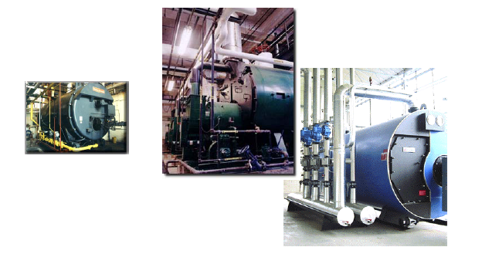
Boilers

Slide 3
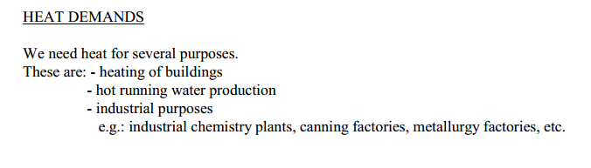
Boilers
Apa itu boiler?
Rangkaian peralatan untuk mengubah energi kimia dalam bahan bakar menjadi energi termal atau panas laten dalam uap.
Kenapa membutuhkan boiler?

Slide 4
Boilers
STEAM TO PROCESS
EXHAUST GAS
VENT
STACK
DEAERATOR
ECO-NOMI-ZER
PUMPS
BOILER
VENT
BURNER
WATER SOURCE
BLOW DOWN SEPARATOR
FUEL
BRINE
CHEMICAL FEED
SOFTENERS
Figure: Schematic overview of a boiler room
4

Slide 5
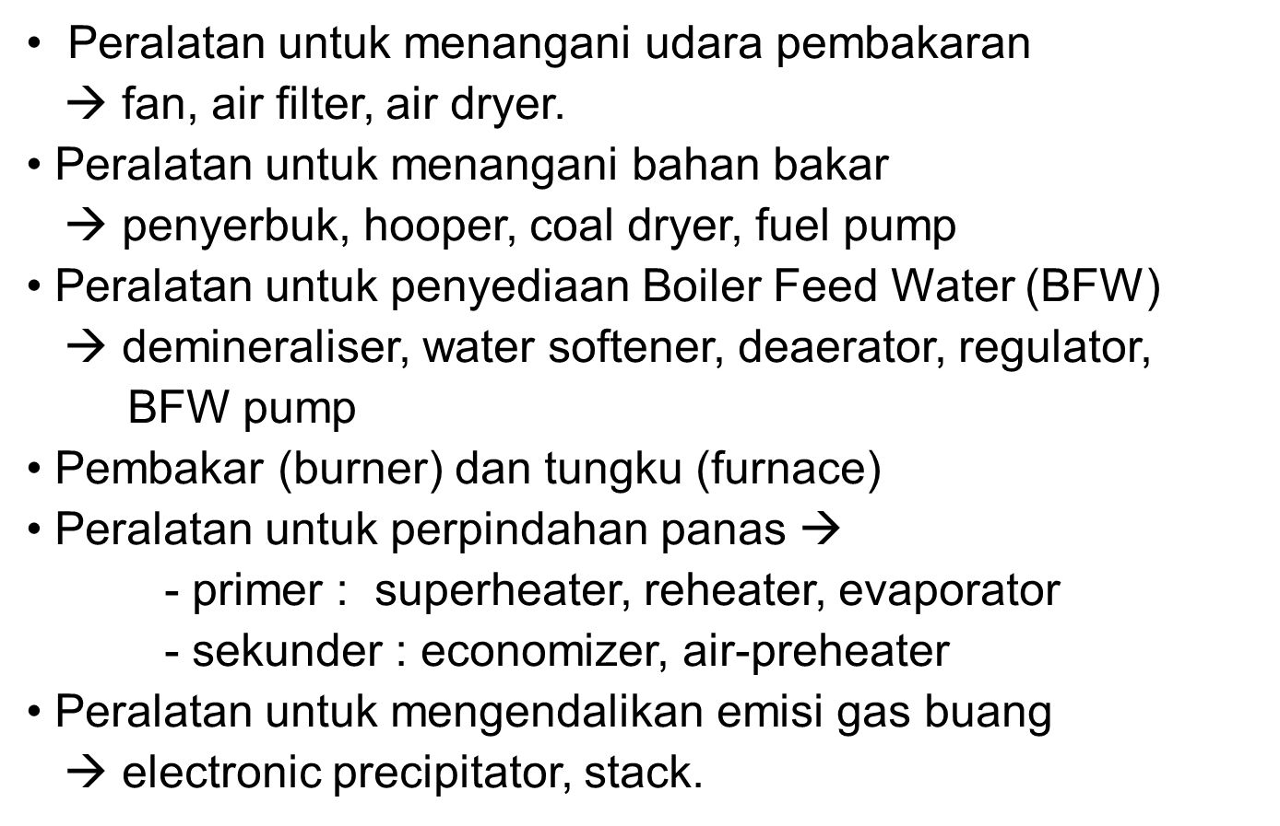
Boilers
Sub – sub peralatan pada boiler

Slide 6
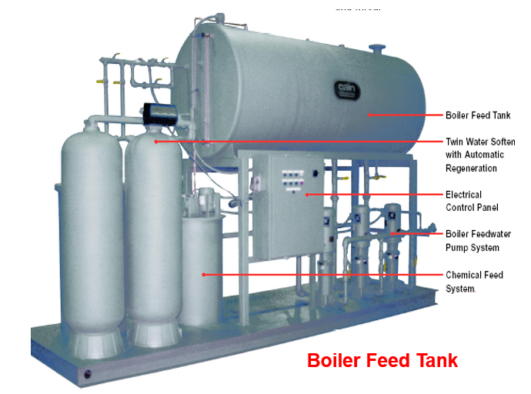
Boilers
Sub – sub peralatan pada boiler

Slide 7
Boilers
Industrial boilers
    Steam generators
    Closed vessels
    made of steel and
    used for generation of steam
    vaporizing water
    combustion of fuels
    eg. coal,coke,oil,wood,saw dust and begesse etc.
    Steam used for producing power,for industrial process work or for heating proposes.

Slide 8
Boilers
STEAM BOILERS
A closed vessel in which steam is produced from water by combustion of fuel

Slide 9
Boilers
Purpose of boilers
For generating power in steam engines or steam turbines
In textile industries for sizing and bleaching
For heating the buildings in cold weather and for producing hot water for hot water supply

Slide 10
Boilers
Primary requirements of a boiler
The water must be contained safely
The steam must be safely delivered in desired condition (as regard its pressure, temperature, quality and required rate)

Slide 11
Boilers
Steam boiler accessories
Feed pumps: Used to deliver feed water to the boiler. It is desirable that the quantity of water supplied should be at least equal to that evaporated and supplied to the engine
Injector: to feed water into the boiler
Economizer: a device in which the waste heat of the flue gases is utilized for heating the feed water
Air pre-heater: to increase the temperature of air before it enters the furnace.

Slide 12
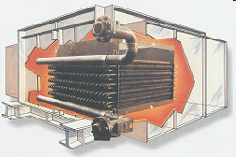
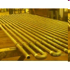
Boilers
Steam boiler accessories
Economizer

Slide 13
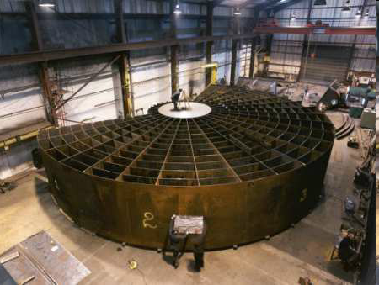
Boilers
Steam boiler accessories
Air pre-heater

Slide 14
Boilers
Steam boiler accessories
Super heater: to increase the temperature of the steam above its saturation point
Steam consumption of the engine or turbine is reduced
Efficiency of the steam plant is increased
Losses due to condensation in the cylinders and the steam pipes are reduced.
Why we use superheated steam?

Slide 15
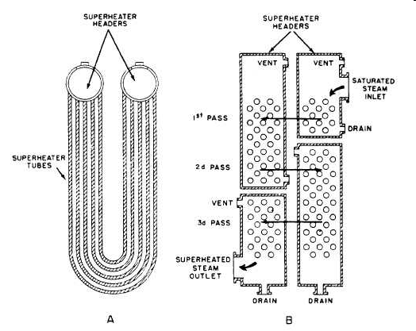
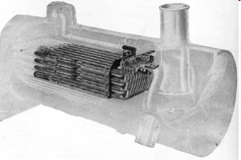
Boilers
Steam boiler accessories
Super heater: to increase the temperature of the steam above its saturation point

Slide 16
Boilers
Classification of boilers
Horizontal, vertical or inclined
Fire tube and water tube
Externally fired and internally fired
Forced circulation and natural circulation
High pressure and low pressure
Stationary and portable
Single tube and multi tube

Slide 17
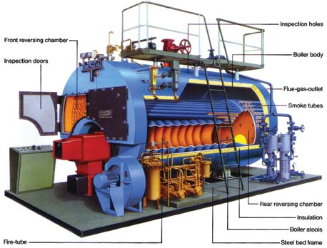
Boilers
Fire tube boilers
If hot gases are inside the tube and water is outside the tube

Slide 18
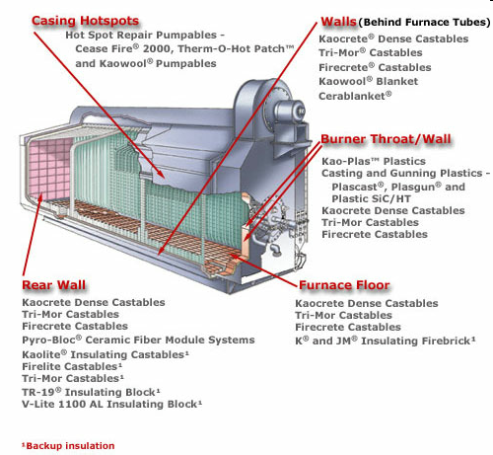
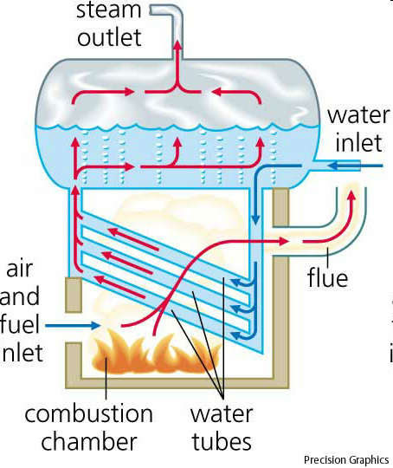
Boilers
Water tube boilers
If water is inside the tube and hot gases are outside the tube

Slide 19
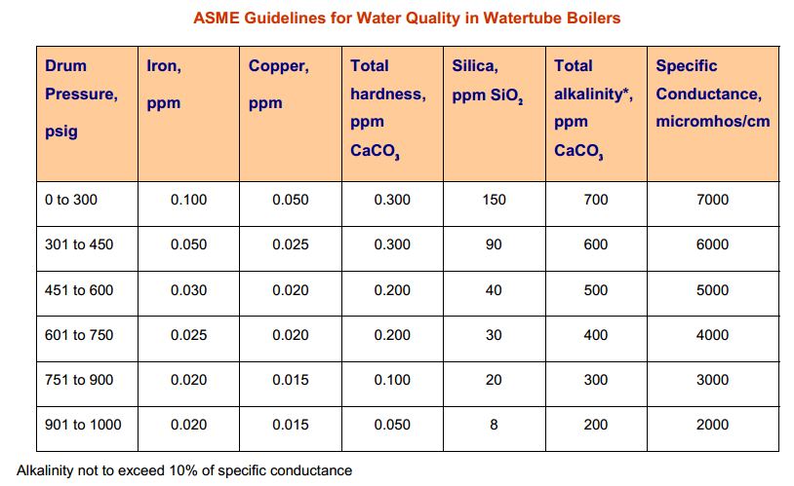
Boilers
Water tube boilers

Slide 20
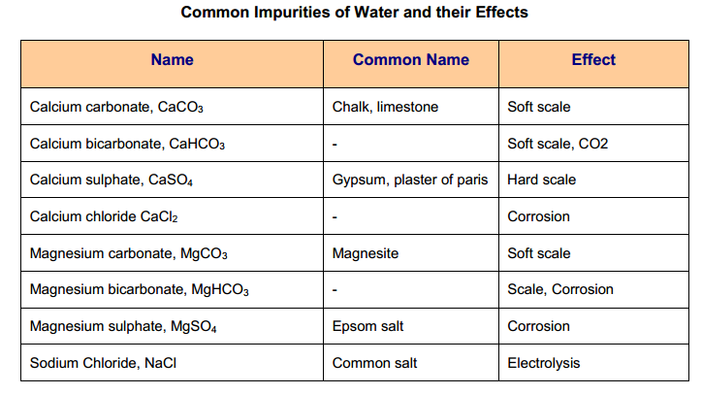
Boilers
Water tube boilers

Slide 21
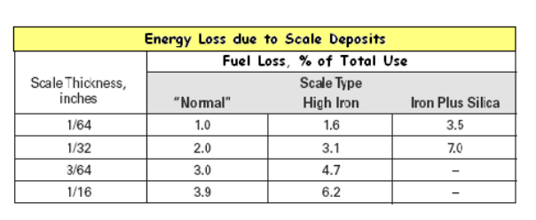
Boilers
Water tube boilers

Slide 22
Boilers
Comparison of water tube and fire tube boiler
Particulars | Fire-tube boilers | Water-tube boilers
Position of water and hot gases | Hot gases inside the tubes and water outside the tubes | Water inside the tubes and hot gases outside the tubes
Mode of firing | Generally internally fired | Externally fired
Operation pressure | Limited to 16 bar | Can go up to 100 bar
Rate of steam production | Lower | Higher
Suitability | Not suitable for large power plants | Suitable for large power plants
Risk on bursting | Involves lesser risk of explosion due to lower pressure | More risk on bursting due to high pressure
Floor area | For a given power it occupies more floor area | For a given power it occupies less floor area
Construction | Difficult | Simple

Slide 23
Boilers
Comparison of water tube and fire tube boiler
Particulars | Fire-tube boilers | Water-tube boilers
Transportation | Difficult | Simple
Shell diameter | Large for same power | Small for same power
Chances of explosion | Less | More
Treatment of water | Not so necessary | More necessary
Accessibility of various parts | Various parts not so easily accessible for cleaning, repair and inspection | More accessible
Requirement of skill | Require less skill for efficient and economic working | Require more skill and careful attention

Slide 24
Boilers
Classification of boilers based on combustion equipment
Solid fuels fired
Hand fired
Stoker fired
Pulverized fuel fired
Underfeed stockers
Overfeed stockers
Unit system
Central system
Both

Slide 25
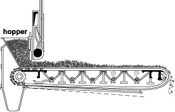
Boilers
Travelling grate stoker

Slide 26
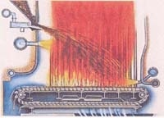
Boilers
Spread stoker

Slide 27
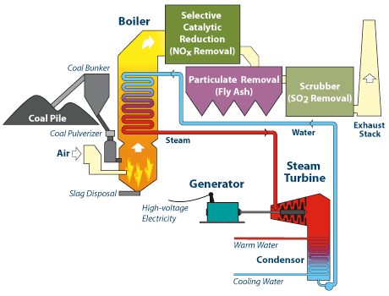
Boilers
Pulverized fuel firing

Slide 28
Boilers
Classification of boilers based on combustion equipment
Liquid fuel fired
Injection system
Evaporator system
Combination of both

Slide 29
Boilers
Classification of boilers based on combustion equipment
Gaseous fuel fired
Atmospheric pressure system
High pressure system

Slide 30
Boilers
Boiler control
Basic control:
- Feed water and drum level control
- Steam pressure control
- Steam temperature control

Slide 31
Boilers
Boiler Mountings and Accessories
Fitting and devices which are necessary for the safety and control are knows as boiler mountings
Fitting or devices which are provided to increase the efficiency of the boiler and help in the smooth working of the plant are knows as boiler accessories.
Fittings which are essential from the safety point of view are as follows,
Water level indicators
Safety valves
Combined high steam and low water safety valve
Fusible plug

Slide 32
Pressure gauge
To record the steam pressure at which steam is generated in the boiler
A bourdon pressure gauge in its simplest form consists of a simple elastic tube
One end of the tube is fixed and connected to the steam space in the boiler
Other end is connected to a sector through a link

Slide 33
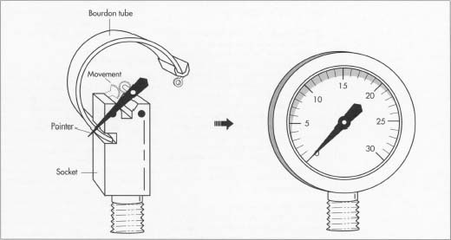
Pressure gauge

Slide 34
Fusible plug
To extinguish fire in the event of water level in the boiler shell falling below a certain specified limit
It is installed below boiler’s water level

Slide 35
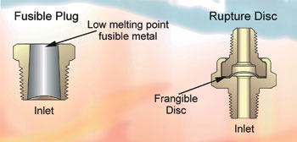
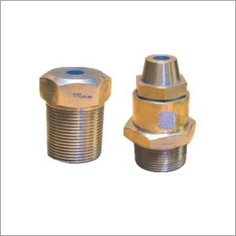

Slide 36
Steam stop valve
A valve is a device that regulates the flow of a fluid (gases , fluidized solids slurries or liquids) by opening or closing or partially obstructing various passageways
Function : to shut off or regulate the flow of steam from the boiler to the steam pipe or steam from the steam pipe to the engine

Slide 37
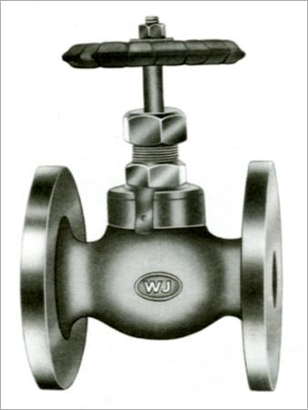
Steam stop valve

Slide 38
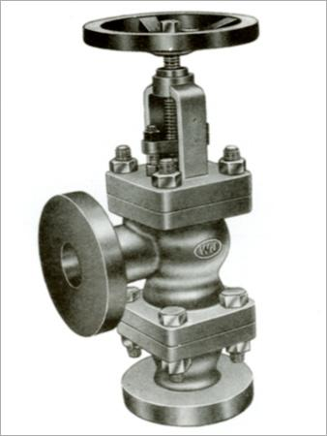
Feed check valve
To allow the feed water to pass in to the boiler
To prevent the back flow of water from the boiler in the event of the failure of the feed pump

Slide 39
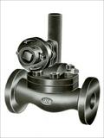
Blow off cock
To drain out water from the boiler for internal cleaning inspection or other purposes

Slide 40
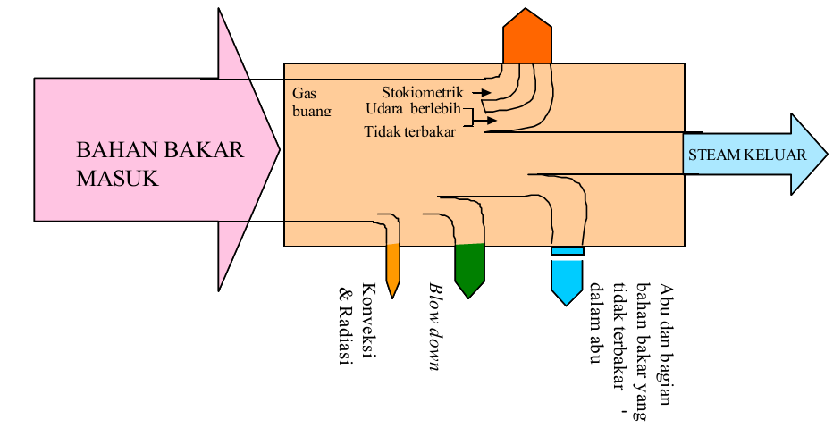
Efisiensi boiler
Evaluasi kinerja boiler
Neraca energi pada boiler

Slide 41
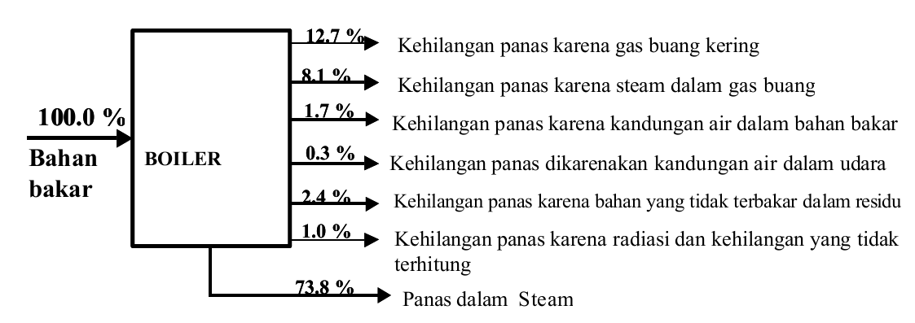
Efisiensi boiler
Energy losses

Slide 42
Efisiensi boiler
Efisiensi termis boiler
“ persen energi (panas) masuk yang digunakan secara efektif pada steam yang dihasilkan.”
Ada dua metode yang digunakan:
Metode langsung: energi yang didapat dari fluida kerja (air dan steam) dibandingkan dengan energi yang terkandung dalam bahan bakar boiler.
Metode tak langsung: efisiensi merupakan perbedaan antara kehilangan dan energi yang masuk.

Slide 43
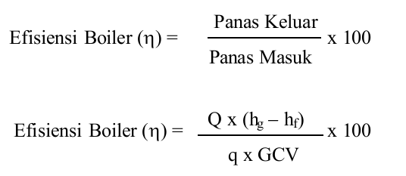
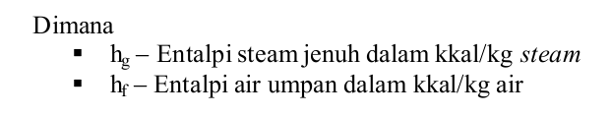
Efisiensi boiler
Metode langsung

Slide 44
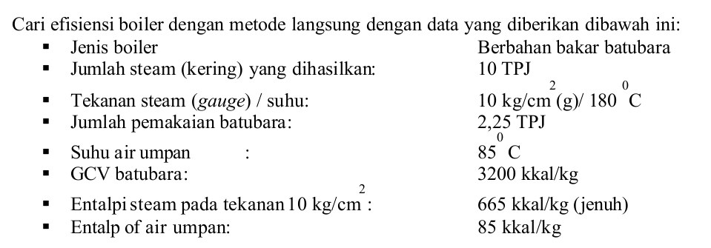
Efisiensi boiler
Metode langsung

Slide 45

Efisiensi boiler
Metode tak langsung
British Standard, BS 845:1987 dan USA Standard ASME PTC-4-1 Power Test Code Steam Generating Units .

Slide 46
Efisiensi boiler
Metode tak langsung
British Standard, BS 845:1987 dan USA Standard ASME PTC-4-1 Power Test Code Steam Generating Units .

Slide 47
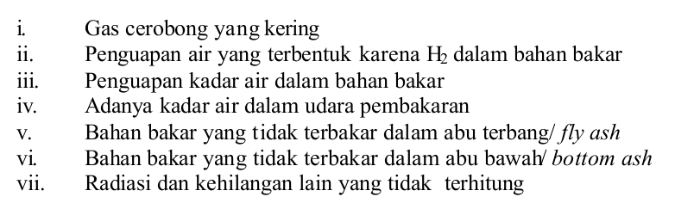
Efisiensi boiler
Metode tak langsung

Slide 48
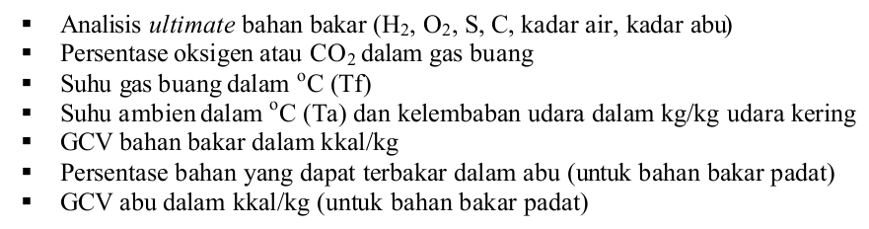
Efisiensi boiler
Metode tak langsung

Slide 49
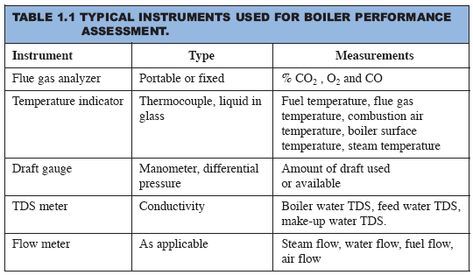
Efisiensi boiler
Metode tak langsung

Slide 50
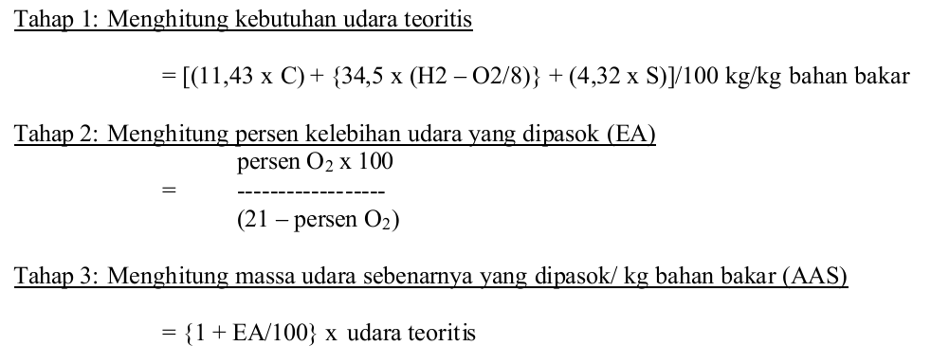
Efisiensi boiler
Metode tak langsung

Slide 51
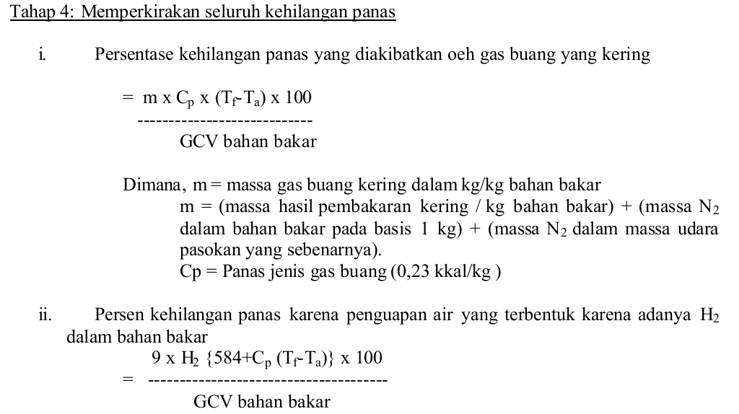
Efisiensi boiler
Metode tak langsung

Slide 52
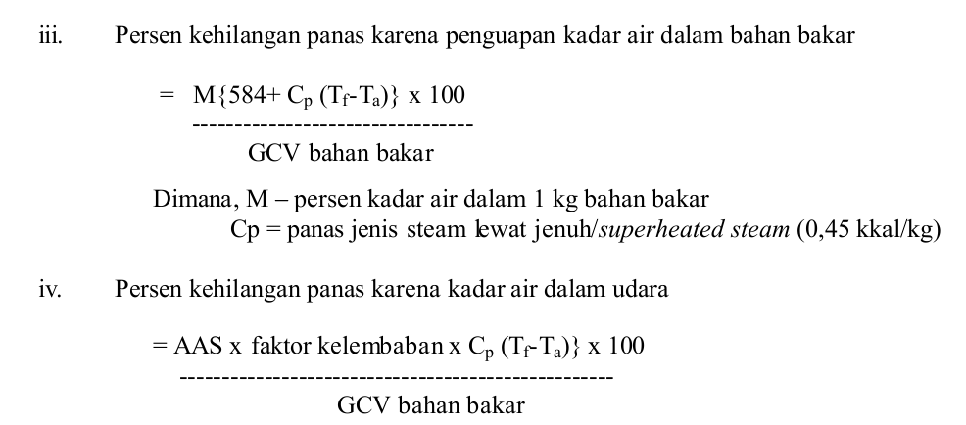
Efisiensi boiler
Metode tak langsung

Slide 53
Efisiensi boiler
Metode tak langsung

Slide 54
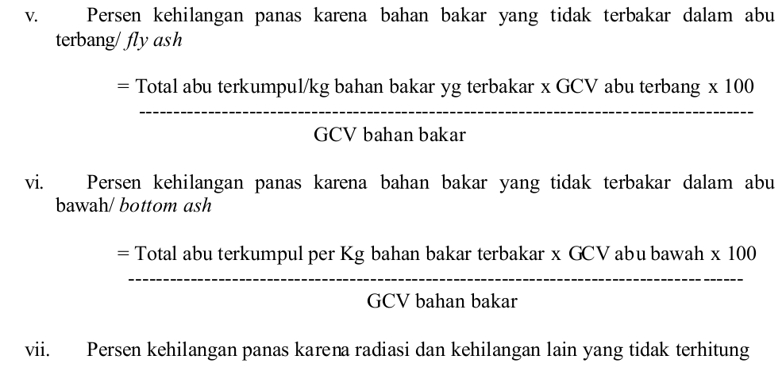
Efisiensi boiler
Metode tak langsung

Slide 55
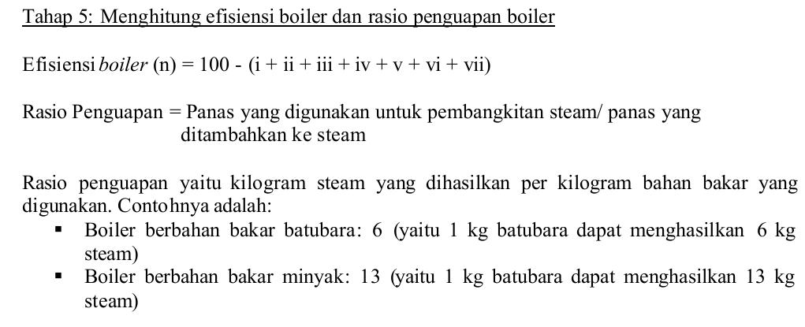
Efisiensi boiler
Metode tak langsung

Slide 56
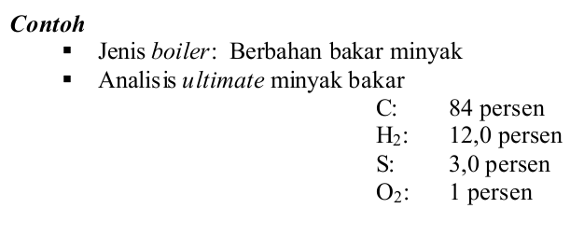
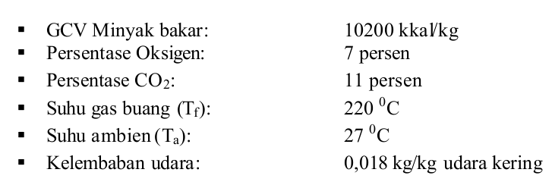
Efisiensi boiler
Metode tak langsung

Slide 57
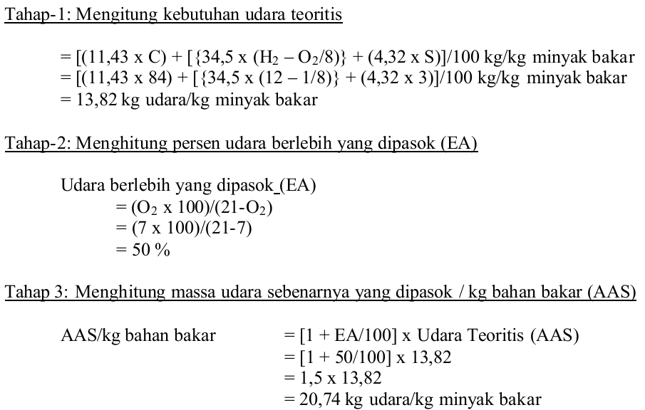
Efisiensi boiler
Metode tak langsung

Slide 58
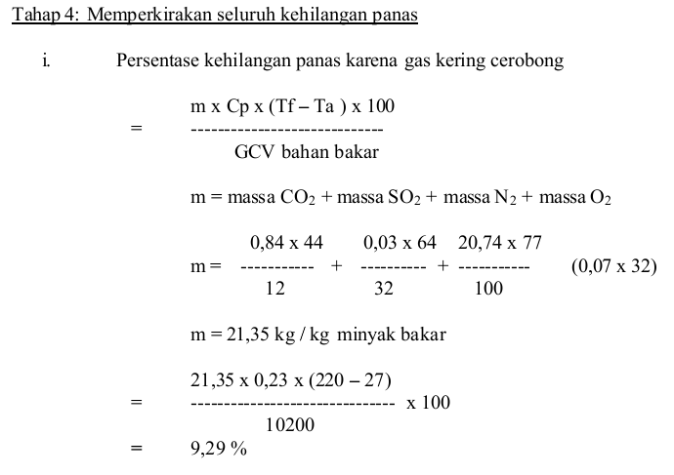
Efisiensi boiler
Metode tak langsung

Slide 59
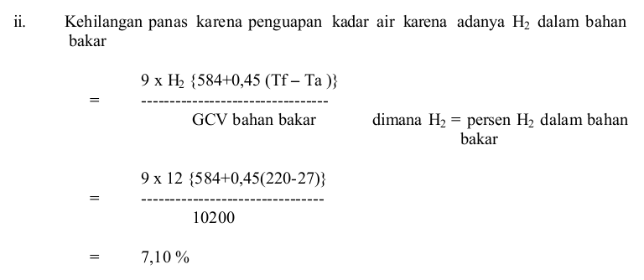
Efisiensi boiler
Metode tak langsung

Slide 60
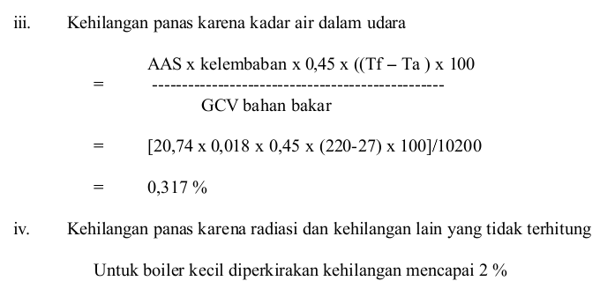
Efisiensi boiler
Metode tak langsung

Slide 61
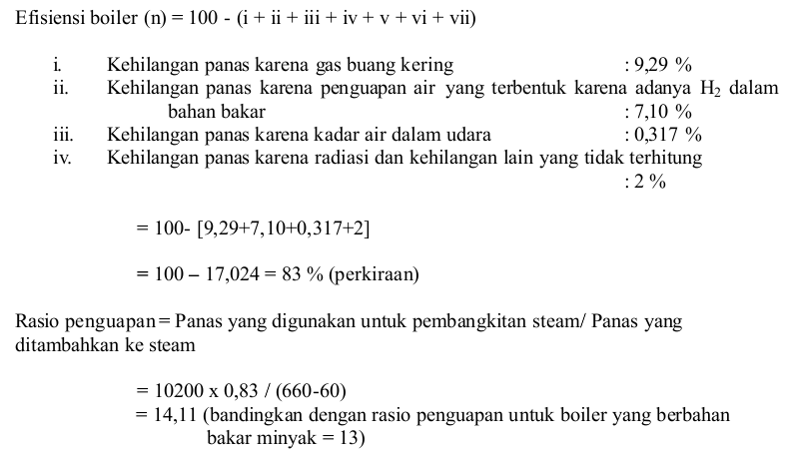
Efisiensi boiler
Metode tak langsung

Slide 62
Efisiensi boiler
Case study
Sebuah boiler menggunakan bahan bakar minyak kualitas tinggi (hanya berisi hidrokarbon) yang memiliki panas pembakaran standar – 43.515 J g-1 pada 25 C dengan CO2(g) dan H2O(l) sebagai produk. Temperatur bahan bakar dan minyak masuk ke ruang pembakaran pada 25 C. Udara dianggap kering. Gas hasil pembakaran keluar dari boiler pada 300 C, dan analisis rata-ratanya adalah (basis kering) 11,2% CO2, 0,4% CO, 6,2% O2 dan 82,2% N2. Berapa bagian dari panas pembakaran yang ditransfer sebagai panas ke boiler?

Slide 63
Efisiensi boiler
Solution
Basis: 100 mol gas hasil pembakaran kering:
CO₂ 11,2 mol
CO 0,4 mol
O₂ 6,2 mol
N₂ 82,2 mol
------------------------
Total 100,0 mol
NERACA O₂
Masuk
O₂ masuk (dalam udara) = 21,85 mol
Keluar
Dalam CO₂ = 11,20 mol
Dalam CO = 0,20 mol
O₂ sisa = 6,20 mol
---------------------------------------------
Total O₂ selain H₂O = 17,60 mol
Jadi O₂ yang bereaksi membentuk H₂O = 21,85 – 17,6 = 4,25 mol
H₂O yang terbentuk = 2 (4,25) = 8,50 mol
Total O₂ yang bereaksi = 11,2 + 0,2 + 4,25 = 15,65 mol
Neraca massa C
keluar
Sebagai CO₂ = 11,20 mol
Sebagai CO = 0,40 mol
---------------------------------------
Total = 11,60 mol
Masuk
Mol C masuk = mol C keluar = 11,60 mol
NERACA H₂
Keluar
Sebagai H₂O = 8,50 mol
Masuk
Mol H₂ masuk = mol H₂ keluar = 8,50 mol
C dan H₂ semuanya berasal dari bahan bakar, sehingga total berat bahan bakar yang masuk adalah = (11,60) (12) + (8,50) (2) = 156,2

Slide 64
Efisiensi boiler
Jika semua bahan bakar terbakar sempurna membentuk CO₂(g) dan H₂O(l) pada 25°C, maka panas pembakarannya adalah:
Solution
Analisis hasil pembakaran menunjukkan bahwa pembakaran berlangsung tidak sempurna dan H₂O berupa gas bukan cairan.
Reaksi yang terjadi
C_{11,6}H₁₇(l) + 15,65 O₂(g) → 11,2 CO₂(g) + 0,4 CO(g) + 8,5 H₂O(g)
Reaksi di atas merupakan penjumlahan dari reaksi² sbb.:
C_{11,6}H₁₇(l) + 15,85 O₂(g) → 11,6 CO₂(g) + 8,5 H₂O(l)
8,5 H₂O(l) → 8,5 H₂O(g)
0,4 CO₂(g) → 0,4 CO(g) + 0,2 O₂(g)
Jika dimasukkan ke persamaan untuk ΔH_{P}°:
Panas reaksi standar total pada 25°C:
= 940.660 J
= – 6.309.740 + 940.660 = – 5.369.080 J
Proses pembakaran ini merupakan proses alir tunak dengan:
Reaktan pada 1 bar
dan 25°C:
fuel 152,2 g
O₂ 21,85 mol
N₂ 82,20 mol
Produk pada 1 bar
dan 300°C:
CO₂ 11,2 mol
CO 0,4 mol
H₂O 8,5 mol
O₂ 6,2 mol
N₂ 82,2 mol
W_{S} = 0
ΔE_{K} = 0
ΔE_{P} = 0
Maka: ΔH = Q
Q = – 5.369.080 J merupakan panas yang ditransfer ke boiler
Jadi fraksi panas pembakaran yang ditransfer ke boiler adalah:

Slide 65
Thank You !

